Slide 1
MOVIE AWARDS CEREMONY INFOGRAPHICS
Here is where this template begins

Slide 2
About Movie Awards Ceremony infographics
This template contains an assortment of complementary infographic resources for the Movie Awards Ceremony presentation.
These infographics are adapted to the style of the aforementioned presentation, so you can insert them easily and have them completely integrated at once. You just need to do the following:
Select the element that you want to copy
Right-click and choose “Copy”
Go to the slide where you want the element to appear
Right-click and choose “Paste”

Slide 3
Movie Awards Ceremony infographics
Venus
Saturn
Venus has a beautiful name
It’s a gas giant and has rings
Mars
Jupiter
Mars is actually a cold planet
Jupiter is the biggest planet

Slide 4
Movie Awards Ceremony infographics
Venus
Venus has a beautiful name
Mars
Mars is actually a cold planet
Saturn
It’s a gas giant and has rings

Slide 5
Movie Awards Ceremony infographics
75%
50%
Saturn
Mars
Saturn is composed of hydrogen and helium
Despite being red, Mars is very cold
60%
85%
Neptune
Earth
Neptune is the farthest planet from the Sun
Earth is the third planet from the Sun

Slide 6
Movie Awards Ceremony infographics
Earth
Earth is the third planet from the Sun and the only one that harbors life in the Solar System. This is where we all live
Jupiter
Saturn
Neptune
Jupiter is the biggest planet of them all
Saturn is composed of hydrogen and helium
Neptune is the farthest planet from the Sun

Slide 7
Movie Awards Ceremony infographics
Venus
Step 1
Venus has a beautiful name, but also high temperatures
Mars
Step 2
Despite being red, Mars is actually a cold place
Saturn
Step 3
Saturn is the second-largest planet in the Solar System

Slide 8
Movie Awards Ceremony infographics
 | Best Actor | Best Actress | Best Picture
Mercury
Venus
Mars
Saturn
Earth

Slide 9
Movie Awards Ceremony infographics
Venus
Venus has a beautiful name
Mars
Earth
Despite being red, Mars is actually a cold place. It's full of iron oxide dust, which gives the planet its reddish cast
Earth is the planet with life
Mercury
Mercury is a small planet
Neptune
Neptune is far away from us
Saturn
It’s a gas giant and has rings

Slide 10
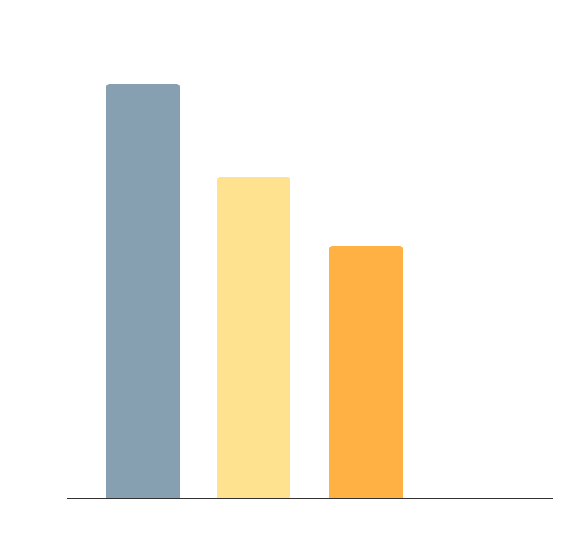
Movie Awards Ceremony infographics
90%
70%
Actor
Actress
Despite being red, Mars is a very cold place
Mercury is the closest planet to the Sun
55%
35%
Director
Film
Earth is the third planet from the Sun
Jupiter is the biggest planet of them all
Follow the link in the graph to modify its data and then paste the new one here. For more info, click here

Slide 11
Movie Awards Ceremony infographics
Awards
Director
Film
Music
Actor
Venus is the second planet from the Sun
Despite being red, Mars is a cold place
Saturn is a gas giant planet and has rings
Jupiter was named after a Roman god

Slide 12

Movie Awards Ceremony infographics
25%
25%
Best film
Best actress
Despite being red, Mars is a very cold place
Mercury is the closest planet to the Sun
35%
15%
Best director
Best actor
Earth is the third planet from the Sun
Jupiter is the biggest planet of them all
Follow the link in the graph to modify its data and then paste the new one here. For more info, click here

Slide 13
Movie Awards Ceremony infographics
Earth
9/10
Earth is the planet where we all live
Jupiter
7/10
Jupiter is the biggest planet
Saturn
Neptune
6/10
Neptune is very far away from us
7/10
Saturn
6/10
Despite being red, Mars is actually a cold place
Saturn has beautiful rings

Slide 14
Movie Awards Ceremony infographics
 | Description | Extra information
Jupiter | Jupiter is a gas giant and the biggest planet in the Solar System | Jupiter is the biggest planet in the Solar System
Earth | Earth is the only planet that harbors life in Solar System | Earth is the beautiful planet where we all live
Saturn | Saturn has several rings and it is composed of hydrogen and helium | Saturn is the second-largest planet in the Solar System

Slide 15
Movie Awards Ceremony infographics
01
04
Jupiter
Saturn
Jupiter is the biggest planet of them all
Saturn is composed of hydrogen and helium
02
03
Earth
Neptune
Earth is the planet where we all live
Neptune is the farthest planet from the Sun

Slide 16
Movie Awards Ceremony infographics
Mercury
Venus
Mars
Jupiter
Earth
Saturn
Neptune
Jupiter is the biggest planet of them all
Earth is the planet where we all live
Saturn is composed of hydrogen and helium
Neptune is the farthest planet from the Sun

Slide 17
Movie Awards Ceremony infographics
Earth
Neptune
Earth is the planet where we all live
Neptune is the farthest planet from the Sun
Jupiter
Saturn
Jupiter is the biggest planet of them all
Saturn is composed of hydrogen and helium

Slide 18
Movie Awards Ceremony infographics
Jupiter
Saturn
5/10
7/10
Jupiter is the biggest planet in the Solar System
Despite being red, Mars is actually a cold place

Slide 19
Movie Awards Ceremony infographics
Mars
Saturn
Despite being red, Mars is very cold
Saturn is composed of hydrogen and helium
Jupiter
Jupiter is the biggest planet of them all
Earth
Neptune
Earth is the planet where we all live
Neptune is the farthest planet from the Sun

Slide 20
Movie Awards Ceremony infographics
Earth
Neptune
Earth is the planet where we all live
Neptune is the farthest planet from the Sun
Jupiter
Saturn
Jupiter is the biggest planet of them all
Saturn is composed of hydrogen and helium

Slide 21
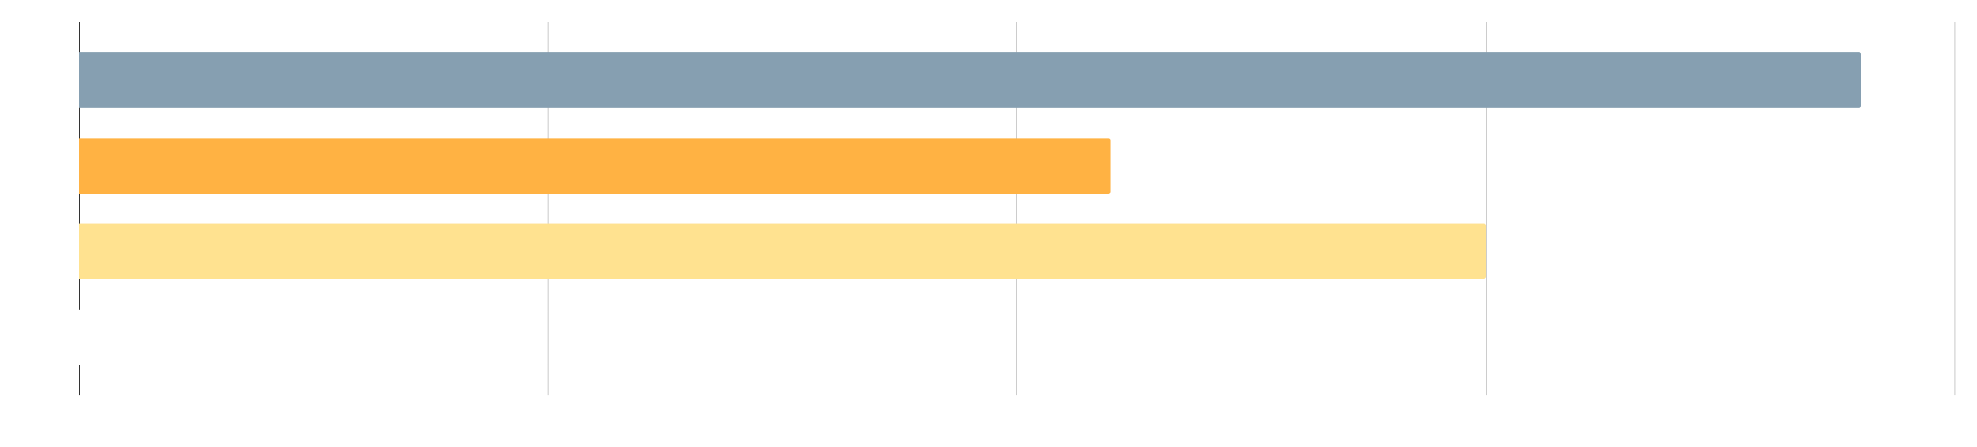
Movie Awards Ceremony infographics
Follow the link in the graph to modify its data and then paste the new one here. For more info, click here
95%
55%
75%
25%
Jupiter
Earth
Saturn
Neptune
Jupiter is the biggest planet of them all
Earth is the planet where we all live
Saturn is composed of hydrogen and helium
Neptune is the farthest planet from the Sun

Slide 22
Movie Awards Ceremony infographics
 | Film1 | Film 2 | Film 3 | Film 4
Director | Mars | Mercury | Venus | Mars
Main actor | Venus | Mars | Jupiter | Earth
Main actress | Venus | Mars | Jupiter | Earth
Supporting actor | Mercury | Venus | Mercury | Venus
Supporting actress | Mercury | Venus | Mercury | Venus

Slide 23
Movie Awards Ceremony infographics
 | Feature 1 | Feature 2 | Feature 3
Film 1 | 25 points | 65 points | 15 points
Film 2 | 85 points | 55 points | 55 points
Film 3 | 45 points | 25 points | 65 points
Film 4 | 155 points | 145 points | 135 points

Slide 24
Movie Awards Ceremony infographics
50%
Mars
Despite being red, Mars is very cold
75%
25%
Saturn
Earth
Saturn is composed of hydrogen and helium
Earth is the third planet from the Sun

Slide 25
Movie Awards Ceremony infographics
Premier | Location | Day | Month
Film 1 | Saturn | Mars | Jupiter
Film 2 | Neptune | Venus | Earth
Film 3 | Earth | Jupiter | Venus
Film 4 | Mars | Saturn | Neptune

Slide 26
Movie Awards Ceremony infographics
Showing | Mon | Tue | Wed | Thu | Fri
Film 1 | 18:00 PM | 19:00 PM | 20:00 PM
Film 2 | 13:00 AM | 15:00 PM
Film 3 |  |  | 20:00 PM | 17:00 PM | 10:00 AM
Film 4 |  | 14:00 PM | 12:00 AM

Slide 27
Movie Awards Ceremony infographics
Award 1: Nominees | Award 2: Nominees | Award 3: Nominees | Award 4: Nominees
Small Red Cold Rocky | Small Red Cold Rocky | Small Red Cold Rocky | Small Red Cold Rocky
Earth is also known as the blue planet | Venus is the second planet from the Sun | Jupiter is the biggest planet of them all | Saturn is a gas giant and has several rings

Slide 28
Movie Awards Ceremony infographics
Jupiter
Jupiter is the biggest planet of them all
5/10
Earth
Earth is the planet where we all live
7/10
Saturn
Saturn is composed of hydrogen and helium
3/10

Slide 29
Movie Awards Ceremony infographics
Mars
They’re simple
You can organize your ideas clearly
You’ll never forget to buy milk!
Earth
Venus
They’re simple
You can organize your ideas clearly
You’ll never forget to buy milk!

Slide 30
Movie Awards Ceremony infographics
Venus
Saturn
Venus has a beautiful name
It’s a gas giant and has rings
Mars
Jupiter
Mars is actually a cold planet
Jupiter is the biggest planet

Slide 31
Movie Awards Ceremony infographics
Earth
Neptune
Earth is the planet where we all live
Neptune is the farthest planet from the Sun
Jupiter
Saturn
Jupiter is the biggest planet of them all
Saturn is composed of hydrogen and helium

Slide 32
Movie Awards Ceremony infographics
Neptune
Neptune is far away from Earth
Venus
Venus is the second planet from the Sun
Earth
1
Earth is the planet where we all live
2
3

Slide 33
Instructions for use
If you have a free account, in order to use this template, you must credit Slidesgo in your final presentation. Please refer to the next slide to read the instructions for premium users.
As a Free user, you are allowed to:
- Modify this template.
- Use it for both personal and commercial projects.
You are not allowed to:
- Sublicense, sell or rent any of Slidesgo Content (or a modified version of Slidesgo Content).
- Distribute Slidesgo Content unless it has been expressly authorized by Slidesgo.
- Include Slidesgo Content in an online or offline database or file.
- Offer Slidesgo templates (or modified versions of Slidesgo templates) for download.
- Acquire the copyright of Slidesgo Content.
For more information about editing slides, please read our FAQs or visit our blog:
https://slidesgo.com/faqs and https://slidesgo.com/slidesgo-school

Slide 34
Instructions for use (premium users)
As a Premium user, you can use this template without attributing Slidesgo.
You are allowed to:
Modify this template.
Use it for both personal and commercial purposes.
Share this template in an editable format with people who are not part of your team.
You are not allowed to:
Sublicense, sell or rent this Slidesgo Template (or a modified version of this Slidesgo Template).
Distribute this Slidesgo Template (or a modified version of this Slidesgo Template) or include it in a database or in any other product or service that offers downloadable images, icons or presentations that may be subject to distribution or resale.
Use any of the elements that are part of this Slidesgo Template in an isolated and separated way from this Template.
Register any of the elements that are part of this template as a trademark or logo, or register it as a work in an intellectual property registry or similar.
For more information about editing slides, please read our FAQs or visit our blog:
https://slidesgo.com/faqs and https://slidesgo.com/slidesgo-school

Slide 35
Infographics
You can add and edit some infographics to your presentation to present your data in a visual way.
Choose your favourite infographic and insert it in your presentation using Ctrl C + Ctrl V or Cmd C + Cmd V in Mac.
Select one of the parts and ungroup it by right-clicking and choosing “Ungroup”.
Change the color by clicking on the paint bucket.
Then resize the element by clicking and dragging one of the square-shaped points of its bounding box (the cursor should look like a double-headed arrow). Remember to hold Shift while dragging to keep the proportions.
Group the elements again by selecting them, right-clicking and choosing “Group”.
Repeat the steps above with the other parts and when you’re done editing, copy the end result and paste it into your presentation.
Remember to choose the “Keep source formatting” option so that it keeps the design. For more info, please visit our blog.

